Slide 1
Text Editor Tricks for Blue Teamers

Slide 2
whoami

Slide 3
TOC

Slide 4
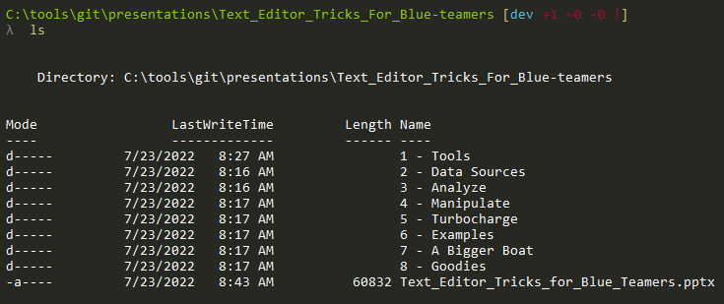

Slide 5
C:\TextEditor\Tools

Slide 6


Slide 7
Built for comfort

Slide 8


Slide 9
Built for speed

Slide 10


Slide 11
C:\TextEditor\Data

Slide 12
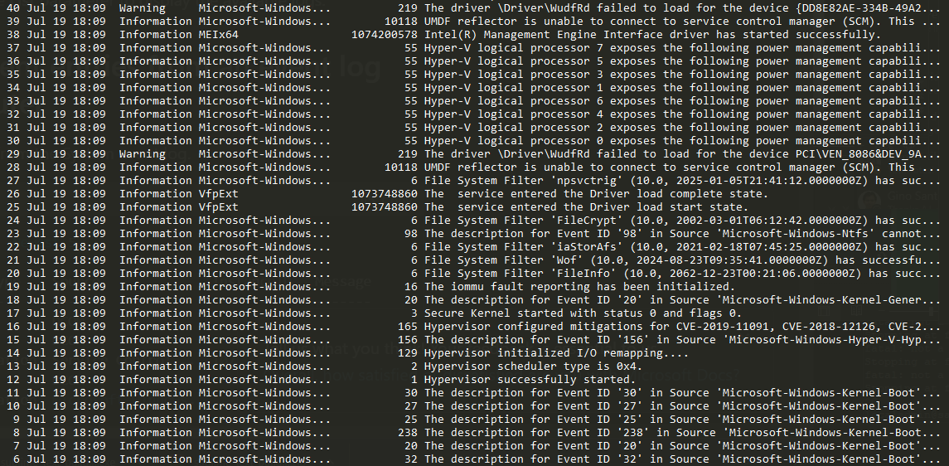
Log files

Slide 13
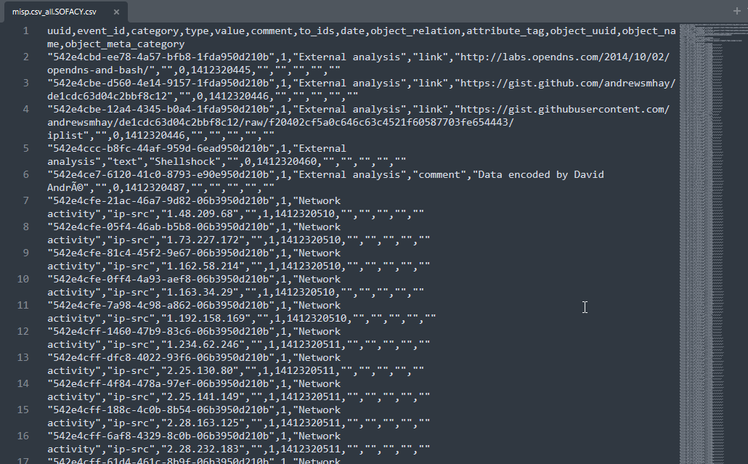
Observables / IOCs

Slide 14
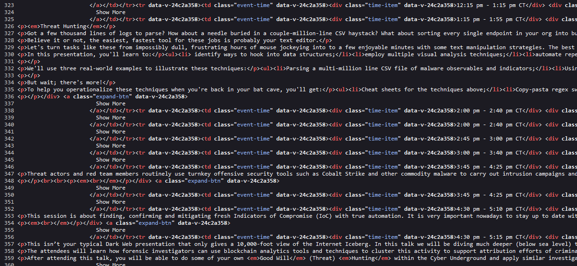
Web data

Slide 15
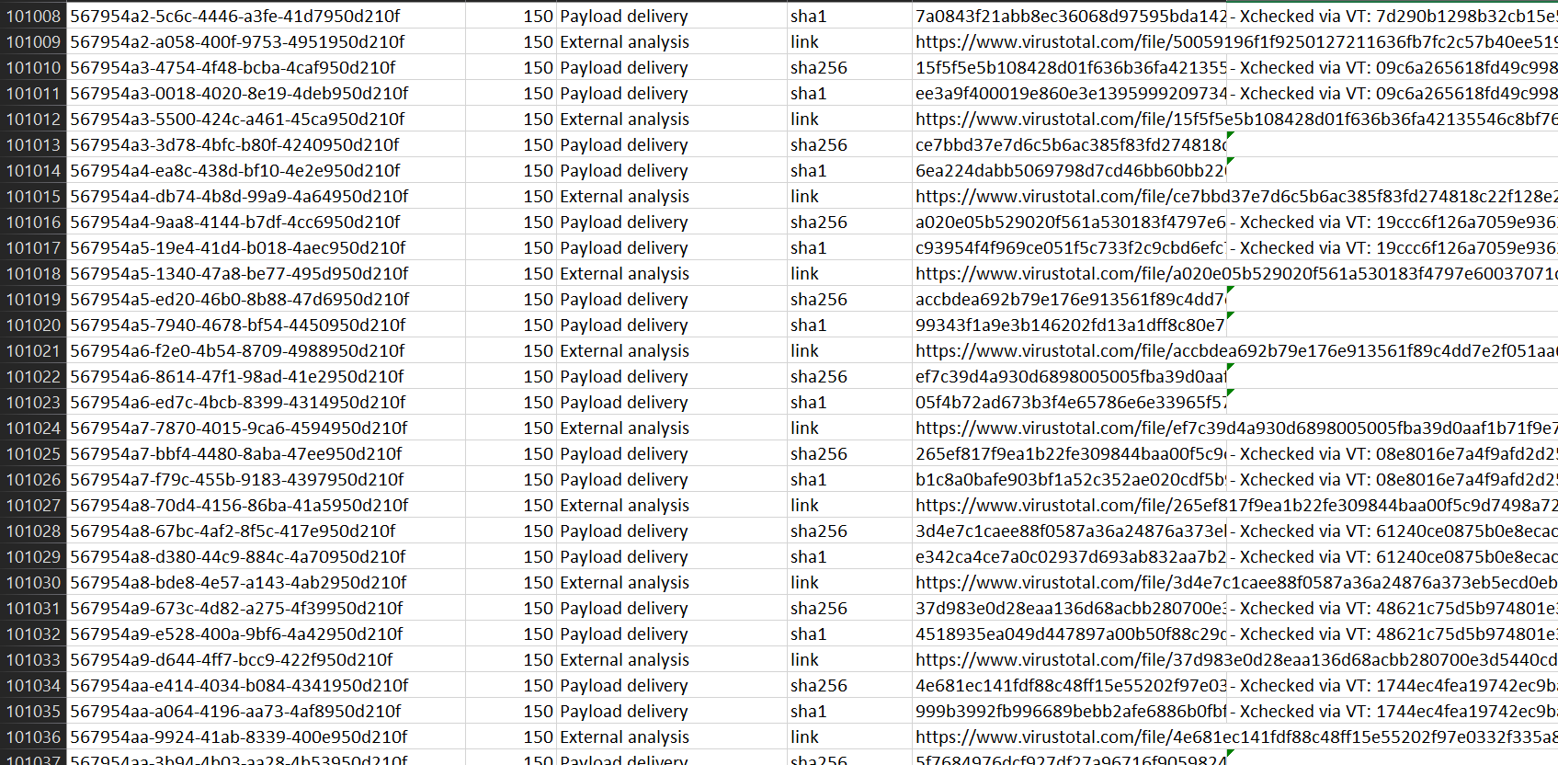
Delimited data

Slide 16
Needs to be text (obvs)

Slide 17
C:\TextEditor\Analysis

Slide 18
“Visual Analysis”

Slide 19
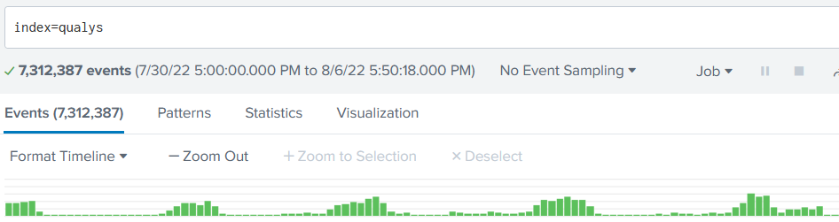
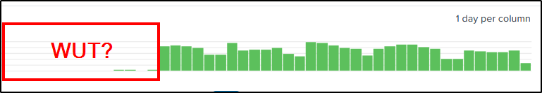

Slide 20
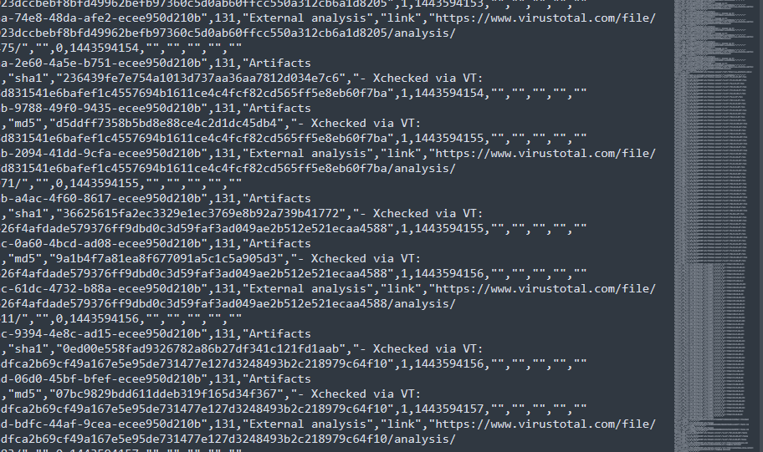

Slide 21
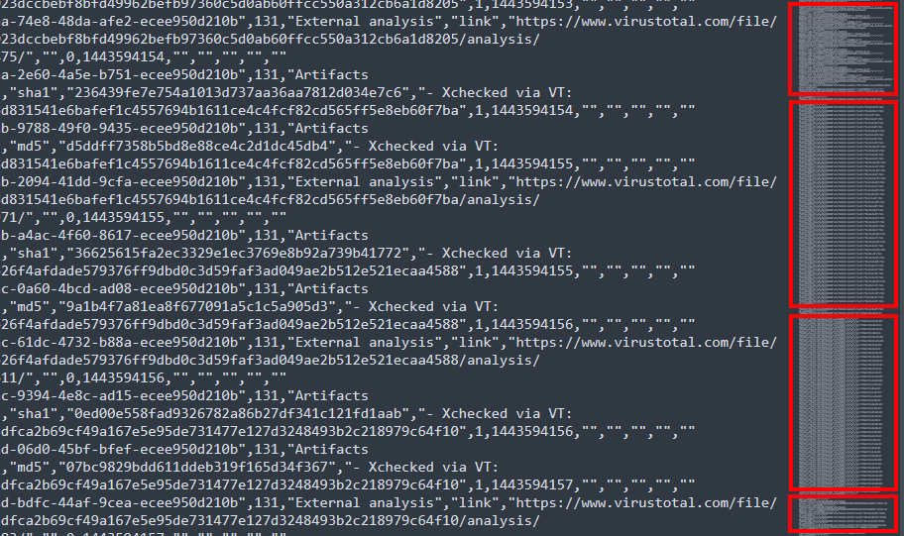

Slide 22
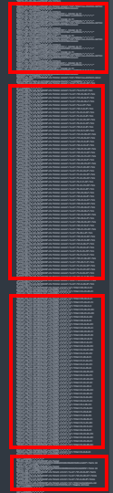
Hashes checked via VT
Destination IPs
URLs
Payload hashes

Slide 23
Sorting reveals patterns

Slide 24


Slide 25
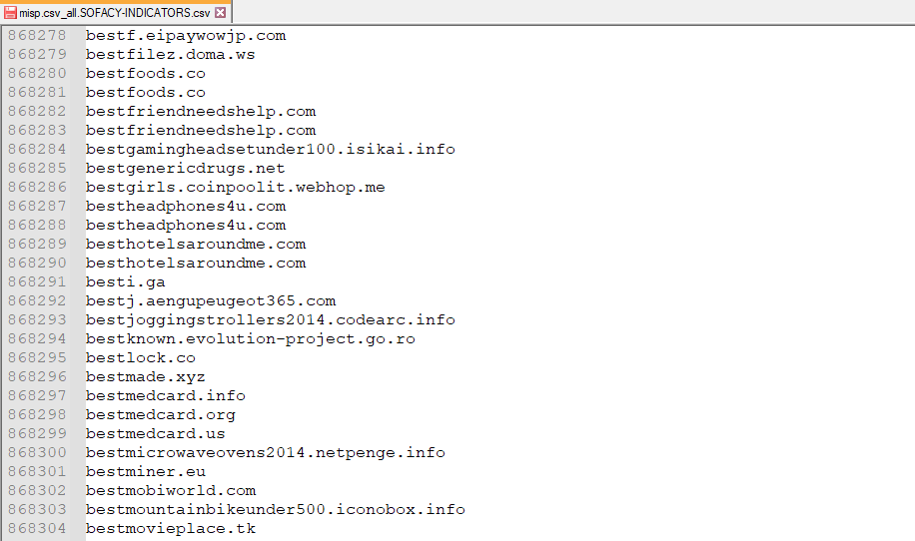

Slide 26
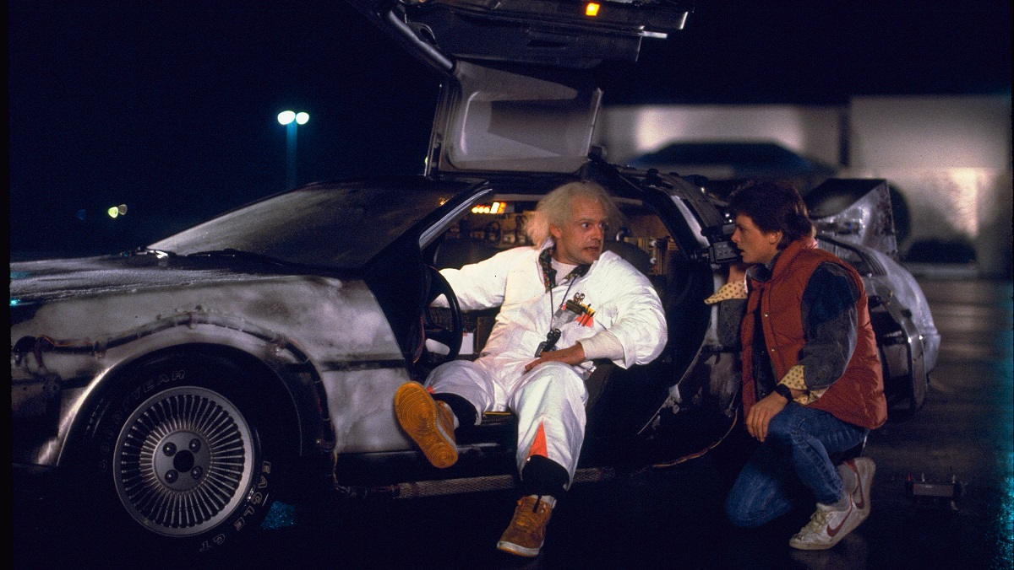

Slide 27


Slide 28


Slide 29
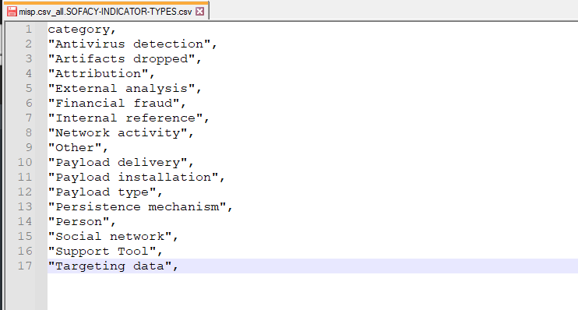

Slide 30


Slide 31
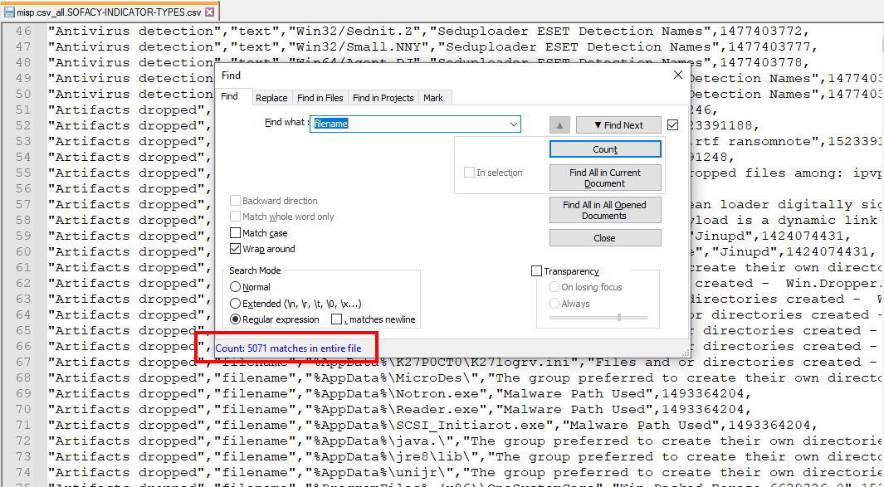

Slide 32
C:\TextEditor\Turbo

Slide 33
Amplification!

Slide 34
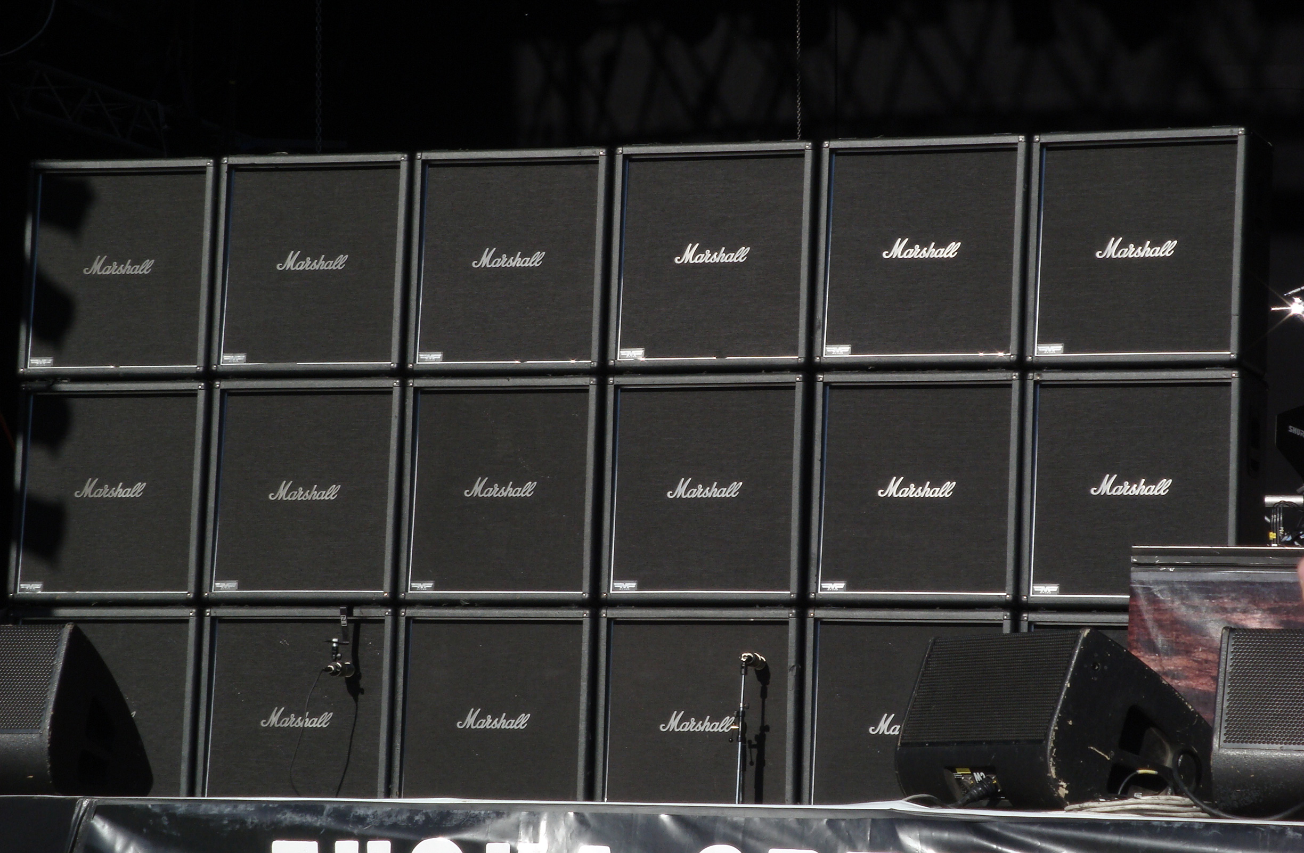

Slide 35
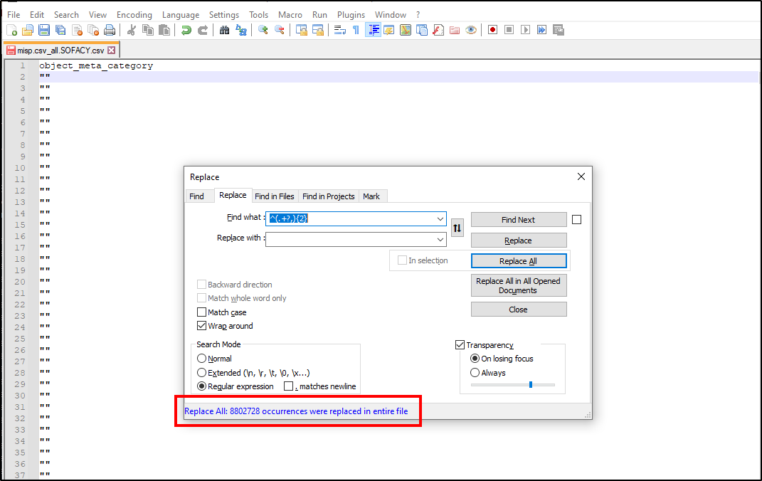

Slide 36


Slide 37
Denoizification

Slide 38
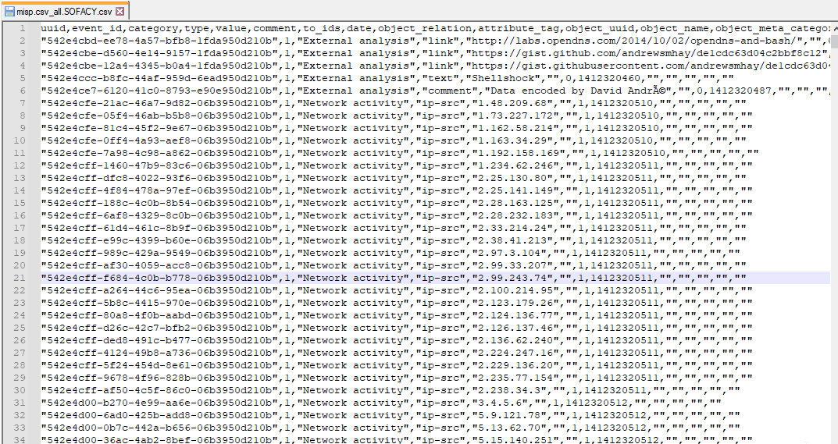

Slide 39
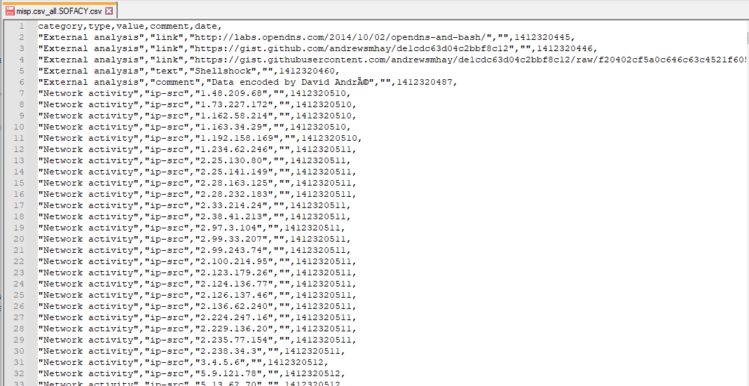

Slide 40
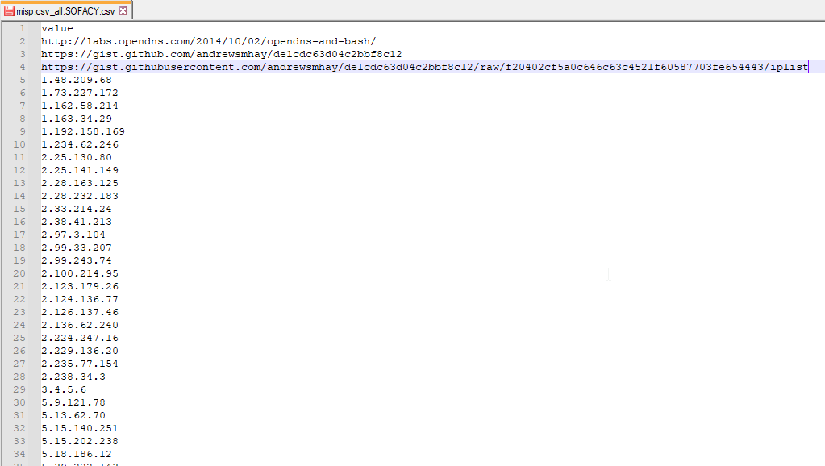

Slide 41


Slide 42
Regex <happy_sigh/>

Slide 43
Diff (two or more)

Slide 44
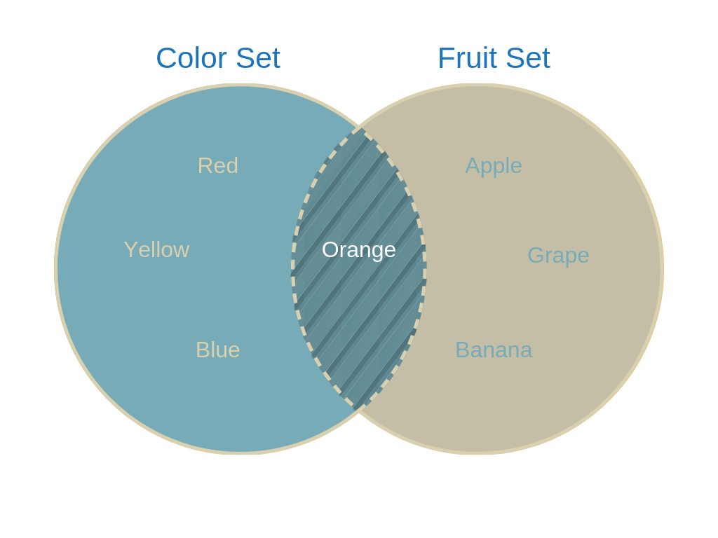

Slide 45
Scriptable patterns

Slide 46


Slide 47
C:\TextEditor\Examples

Slide 48
C:\TextEditor\TimeForOtherTools

Slide 49
Filtering

Slide 50
Data visualization

Slide 51
Pivoting

Slide 52
C:\TextEditor\Goodies

Slide 53
kthxbye

